Slide 1

The Rust programming language
Gary Clynch
School of Enterprise Computing and Digital Transformation
Code samples in https://github.com/gclynch/rust

Slide 2

The Rust Programming Language
Rust is a multi-paradigm general purpose programming language:
  V1 by Graydon Hoare, Mozilla Research in 2010
  Imperative, structured, functional, generic, not object-oriented
  Cross platform, open-source compiler (MIT and Apache dual permissive licenses) https://github.com/rust-lang
  Now managed by the Rust Foundation https://foundation.rust-lang.org
    Mozilla, Google (Android), AWS, Microsoft, Meta, Huawei
  Most “loved “programming language on Stackoverflow surveys for 7 years in a row to 2022 (75K developers)
  Top 20 TIOBE index https://www.tiobe.com/tiobe-index/
  Rust playground https://play.rust-lang.org/

Slide 3
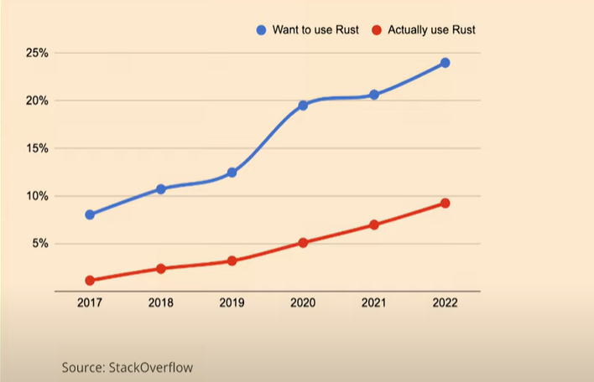

Slide 4
The Rust Programming Language
New stable version every 6 weeks (nightly, beta, stable channels) (currently 1.67.x)
  https://github.com/rust-lang/rust
Objective: memory safety, efficiency, concurrency
  “Speed and Safety”
  Enforces memory safety without using a garbage collector through its “borrow checker”
  Systems programming rather than application programming e.g. CLI tools, embedded, WASM, networking
    e.g. Android, Firecracker (micro VMs), npm, Firefox, Discord read states service (originally written in Go), DropBox sync engine, GNU coreutils, Linux kernel language #2 after C
Strong static typing

Slide 5
The Rust Programming Language
Compiled to machine code, not managed
Similar syntax and performance to C++, motivated by Haskell/Ocaml/Scala
No garbage collection
  Uses “ownership”, “borrowing”, and “lifetimes” - OBRM
  No “null” value – Option<T>
Expression oriented language
  (nearly) every statement is an expression and therefore returns a value; these expression statements can themselves form part of larger expressions
Community driven – Rust RFCs https://rfcbot.rs

Slide 6
The Rust Programming Language
Traits
  Ad-hoc polymorphism (“the ability to substitute one object for another if they both have certain characteristics”)
Macros – for last resort code re-use - metaprogramming
Structs / Enums (i.e. user-defined types)
  Can contain implementations
Rust does not have exceptions
  Recoverable errors: Result<T, E>
  Unrecoverable errors: panic!

Slide 7
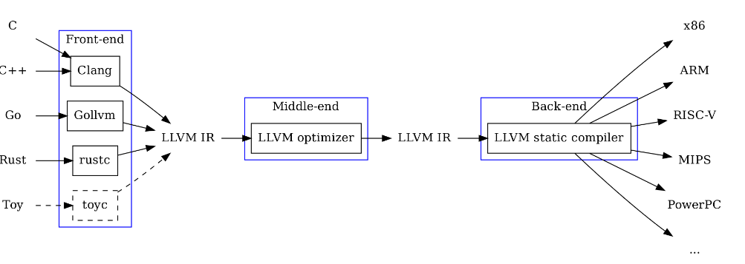
Rust tooling
rustc compiler originally written in Ocaml
  In 2011 it compiled itself (self-hosted)
  Target: LLVM IR (which is then optimised and compiled to target machine code)
IDE support usually via Rust analyzer
clippy, rustfmt

Slide 8
Rust datatypes
Built-in types, tightly integrated into the language
  Scalar primitive types
    Integers (signed and unsigned) (i8 to i128, u8 to u128)
    floating points numbers (f32 and f64)
    characters (char) (Unicode 4 bytes) (whereas a String uses UTF 8)
    booleans (bool)
  Sequence types
    Arrays (static size, on stack, same type) [1, 2, 3]
    Tuples (different types) [1, “hello”, ‘!’]
    Slices (reference to a contiguous sequence of elements (e.g. array or string) in a collection)

Slide 9
Rust datatypes
Built-in types (more)
  Function types
  Trait types (inspired by Haskell)
  Pointer types (reference, smart pointer)
User-defined types (which have “move semantics” by default)
  structs
  enums (disjoint unions, containing variants)

Slide 10
Packaging – Cargo + Crates.io
Cargo is the package manager and build tool for Rust:
  Package = set of crates – cargo.toml manifest
  Crates are binary crates or libraries (src/main.rs, src/lib.rs convention)
    max 1 library crate in a package
  Crates can be structured into modules
  Can call a build script (e.g. make) before cargo build
  Crates.io – centralised package repository/registry for the Rust community, dependencies in cargo.toml
  rustdoc for crate documentation (/// and //!)
  rustc compiles a crate

Slide 11
Rust standard library
In the std crate
  Core types, operations on primitives, threading, I/O, and standard macros etc.
  It is “small” – no date type, no random number generators, no regular expressions – use a 3rd party crate for these
  Available to all crates by default (no need for .toml to define std crate as a dependency)
    to import (so it can be used using a shorten name) use std::env;
    env is a module in the std crate
  Things in the Rust prelude do not need to be imported (e.g. String, Vec<T> etc.)

Slide 12
Rust Functional Programming
Functional programming
  programs are constructed by applying and composing functions
Rust is imperative (“how”) but has functional features:
  Expressions (which return values, “what”) rather than statements
  Functions are first-class citizens
  Immutability
    immutable types/immutable references/persistent data structures
  Anonymous functions and closures
  Pattern matching
  Recursion

Slide 13
Rust Functional Programming
Functional aspects:
  Iterators
    Iterate forwards over a sequence of elements taking one element at a time using next()
    Sequence – array, string, vector, hash map, graph etc.
    Doesn’t matter how the elements are stored
    are lazy (do nothing until consumed)
    Apply higher-order functions (map, fold, filter, any, find etc.) to an iterator
      Iterator adaptors and consumers

Slide 14
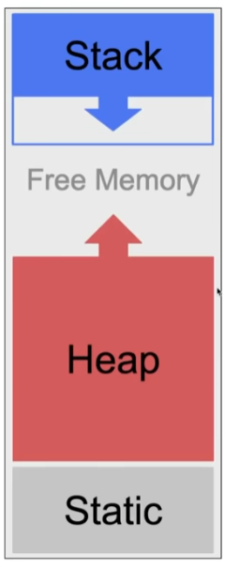
Memory in Rust

Slide 15
Stack v Heap in Rust
In general in Rust fixed size data (i.e. size known at compiler time) is stored on stack, dynamically sizing data (e.g. strings, vectors) are stored on heap
  Stack is automatically managed by the operating system (rather than Rust itself)– all values in Rust are stack allocated by default i.e. including user-defined structs and enums
  Heap for dynamically sizing data (by explicit boxing using Box::new<T> which returns a pointer to the value on heap)
    Rust’s ownership system automatically results in a “drop” of the memory on heap once the owner goes out of scope

Slide 16
Memory Safety in Rust
Memory safety is the property of a program where memory pointers used always point to valid memory, i.e. allocated and of the correct type/size i.e. avoid
  Dangling pointers (pointer that points to data which has been deallocated)
  Double frees (trying to free the same memory twice)
Rust compiler will not compile code with any of the above bugs i.e. we cannot write memory unsafe code

Slide 17
Ownership (OBRM)
Rules:
  Each value (on stack or heap) has an owner (its variable)
  Only one owner at a time
  When owner goes out of scope the value will be dropped by freeing the memory
The owner is responsible for freeing memory if it is on heap
    It is dropped implicitly unless it has a destructor which is run instead (i.e. drop is called automatically on the variable if it implements the Drop trait (e.g. string or vector))
The ownership rules are enforced at compile-time

Slide 18
Moving ownership
By default all types have a “move semantics” i.e. ownership is transferred to another variable (a “move”) on assignment
Types have a “copy semantics” if they implement the Copy trait (and as a result they cannot have destructors i.e. implement Drop trait)
  All primitive types implement the Copy trait (it is an empty trait that just means duplicate by copying the bytes)
  Structs do not implement the Copy trait by default
    If any part of a struct is on heap it cannot implement Copy
    Copy trait can only be implemented for values stored on stack
  A “move” == pass by value (i.e. value is moved to a new owner)
  A “borrow” == pass by reference

Slide 19
Borrowing
A reference (“borrow”) (&) (immutable) can be given to a value (on stack or heap) but that does not transfer ownership, cannot modify something we have an immutable reference to
  A reference is a non owning pointer type
A reference goes out of scope after the line of code it was last used
A variable owns its resource unless it is a reference
A mutable borrow (&mut) must end before the owner can access it again

Slide 20
Smart pointers
Smart pointers usually own the data they point to (unlike references which borrow data)
Provide additional features and metadata over references and are implemented as structs
Smart pointer types:
  for allocating values on heap Box<T> e.g. for recursive types
  “Reference counting” smart pointer type Rc<T>
    Multiple owners, track number of owners, when no owners remain clean up data
  For enforcing borrowing rules at runtime instead of compile time Ref<T> and RefMut<T>

Slide 21
References
The Rust programming language book https://doc.rust-lang.org/book/
The Rust foundation https://foundation.rust-lang.org/
The Rust analyzer https://rust-analyzer.github.io/
Crates https://crates.io/
Stack Overflow survey 2022 https://survey.stackoverflow.co/2022/

